Slide 1
Breast Cancer Detection Model
Arjun Kannan
IBM Data Science Capstone Project

Slide 2
Breast cancer is an uncontrolled growth of breast cells impacting 2.1 million women each year.
In 2020, it still remains a worldwide public health dilemma and is currently the most common tumor in the globe

Slide 3

Predicting Cancer cells is key to saving lives
Early prediction of cancer cells in the mammary glands decrease risk of death by almost 80%.
2.1 Million women every year have breast cancer.
In 2018, it is estimated that 627,000 women died from breast cancer – that is approximately 15% of all cancer deaths among women.

Slide 4
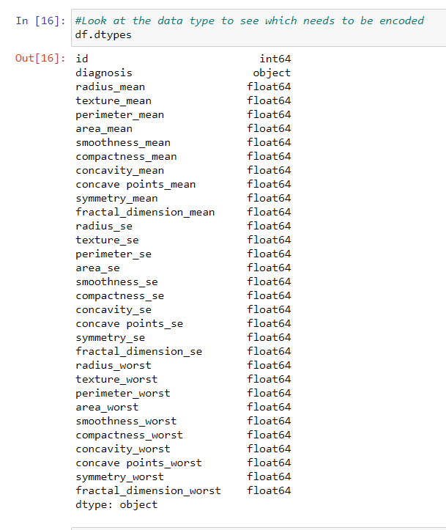
Understanding the data
Deleting Nan or Null Values
Identifying each column type
Identifying Dependent and Independent Variables
Analysis on what ML Technique can be used
Data has been extracted from Kaggle.com

Slide 5
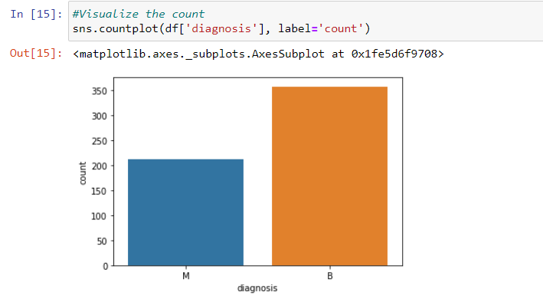
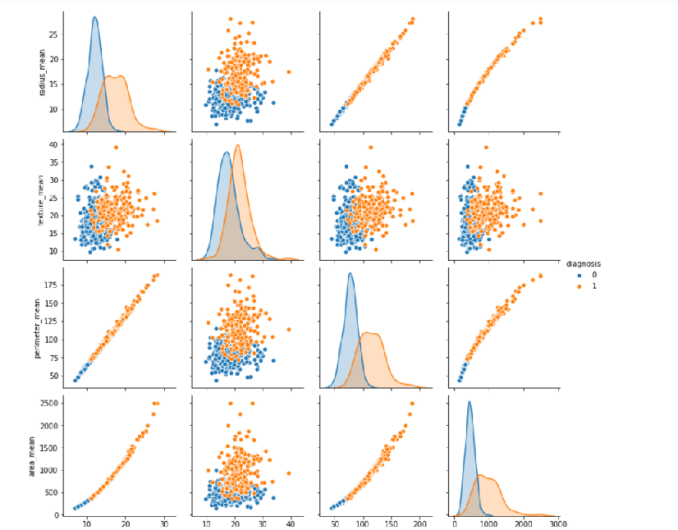
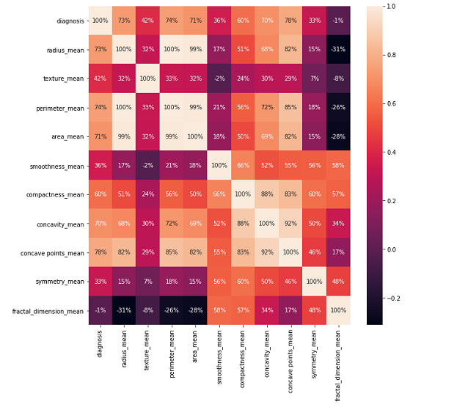
Data Analysis
Identifying Benign and Malignant cells
Pairplot of the different attributes
Visualizing the correlation
Data has been extracted from Kaggle.com

Slide 6
Machine Learning Techniques used:
Logistic Regression
Decision Tree
Random Forest
Logistic regression is a supervised learning classification algorithm used to predict the probability of a target variable..
Decision Tree Analysis is a general, predictive modelling tool that has applications spanning a number of different areas. In general, decision trees are constructed via an algorithmic approach that identifies ways to split a data set based on different conditions.
Random forests or random decision forests are an ensemble learning method for classification, regression and other tasks that operate by constructing a multitude of decision trees at training time and outputting the class that is the mode of the classes or mean prediction of the individual trees.
75% data trained and 25% data is tested
“Diagnosis” column consisting of 2 values – Benign and Malignant as the dependent variable (Y). Rest considered as Independent data (X).
.

Slide 7
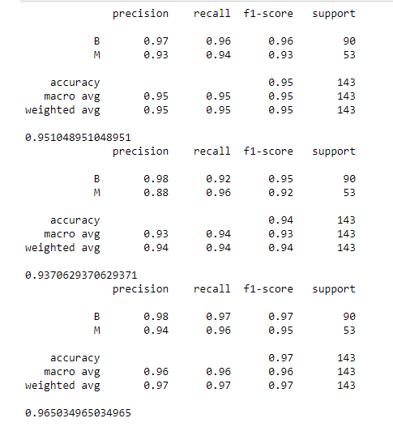
Testing Results
Model 1 – Logistic Regression
Model 2 – Decision Tree
Model 3 – Random Forest
Random Forest classification has the best accuracy at 96.5%

Slide 8
Conclusion
It is evident that the Random Forest Training is the most accurate at 96.5% followed by Logistic Regression at 95.1% and lastly Decision Tree at 93.7%.
When tested, there is a few errors that the Machine makes but provides a very good accuracy rate.
This study is only the beginning of research conducted by the Breast Cancer Research Group and can be pivotal for predicting breast cancer in the future.

